Slide 1
Snake and Ladders game

Slide 2
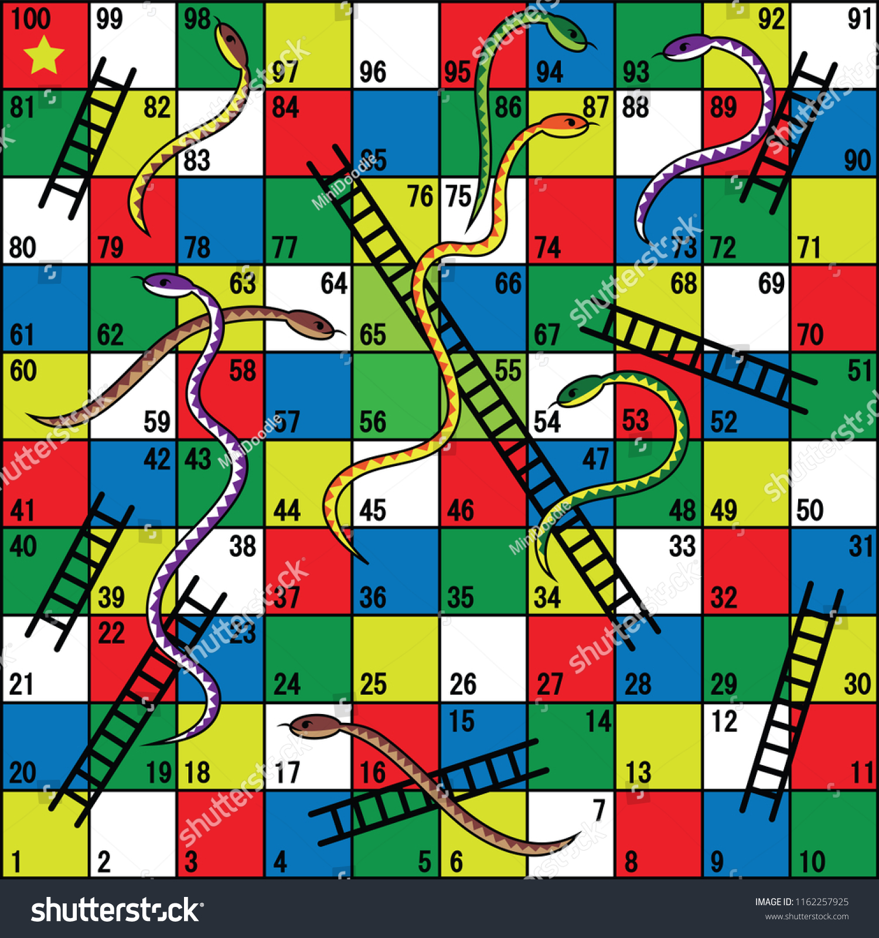
The Problem
Implement snake game using graph

Slide 3
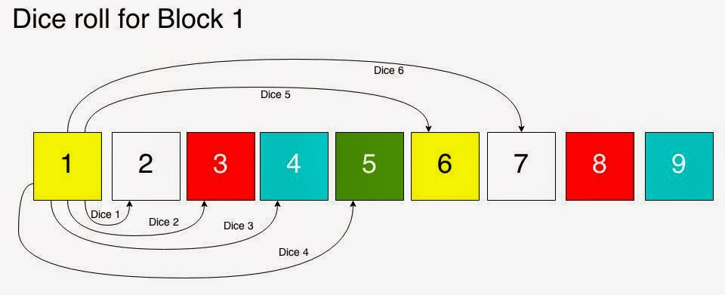
Each block from 1 to 100 is a vertex
Each possible move from a dice roll, is an edge
Start vertex is 1. End vertex is 100.

Slide 4

This is a slide title
Consider this ladder from 4 to 14 and let’s say i am at the block number 1 normally, if my dice roll outcome 3, i would go 4. Now i see that there is a ladder which takes me from 4 to 14.

Slide 5
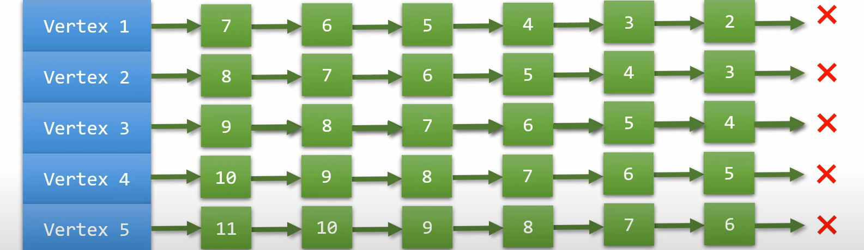
This is our initial graph

Slide 6
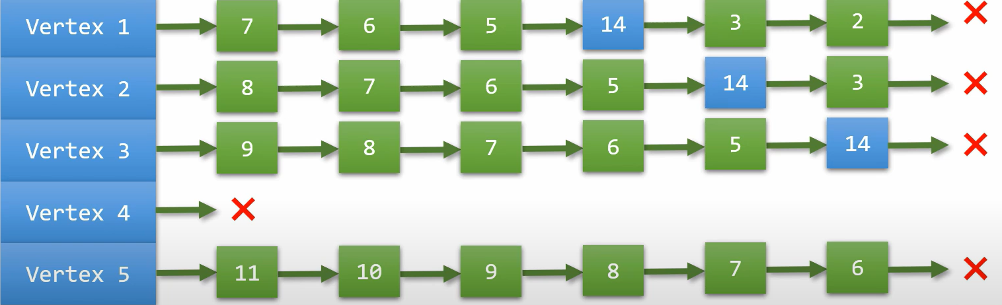
This is our graph after ladder adjustment

Slide 7
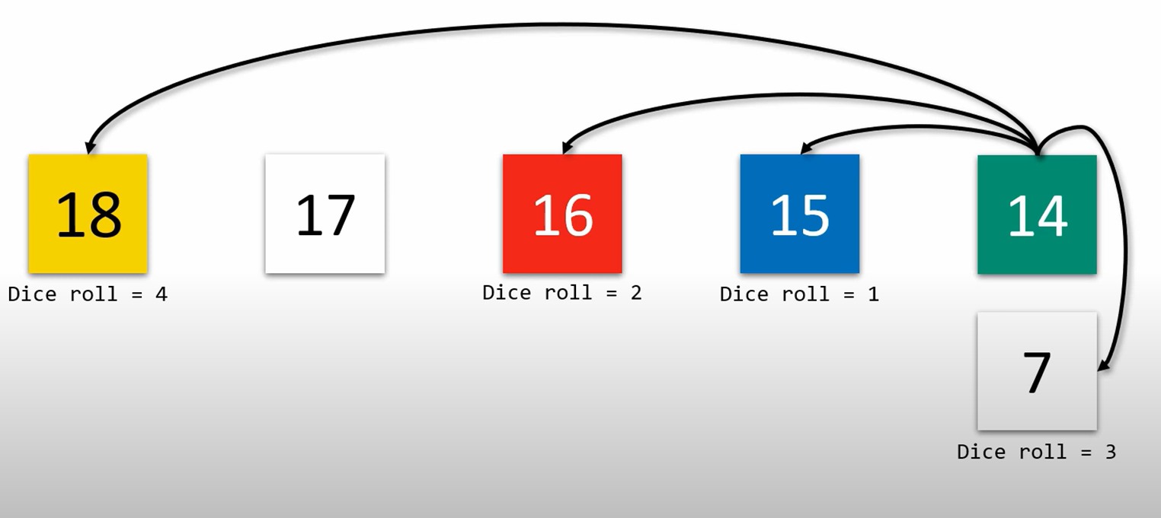
Similar example for the snake at 17

Slide 8

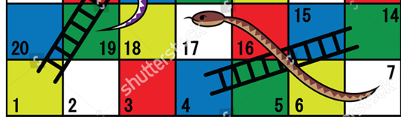
Adjacency List

Slide 9
